Slide 1
Bill Splitting System
Group 5
UI: Randolph Zhao, Liyuan Huang
Java API: Yonghao Zhou, Tianhao Jiang
Backend: Isabella Ma
Notes:
Your team's project presentation should be *exactly* 15 minutes long and everyone should participate, if possible. You should start out with a 5 to 7 minute slide presentation (4-6 slides) describing your project, its architecture, technologies used, and lessons learned. You should then demo the key functionality of your project. There will be a brief period for audience questions afterward. You will be graded on your preparation, clarity, and functionality.

Slide 2

Project Overview
This system is designed to assist people to
record and view their spendings by time and category
split bills with multiple friends conveniently
Code language: Java
Platform: Windows & MacOS

Slide 3
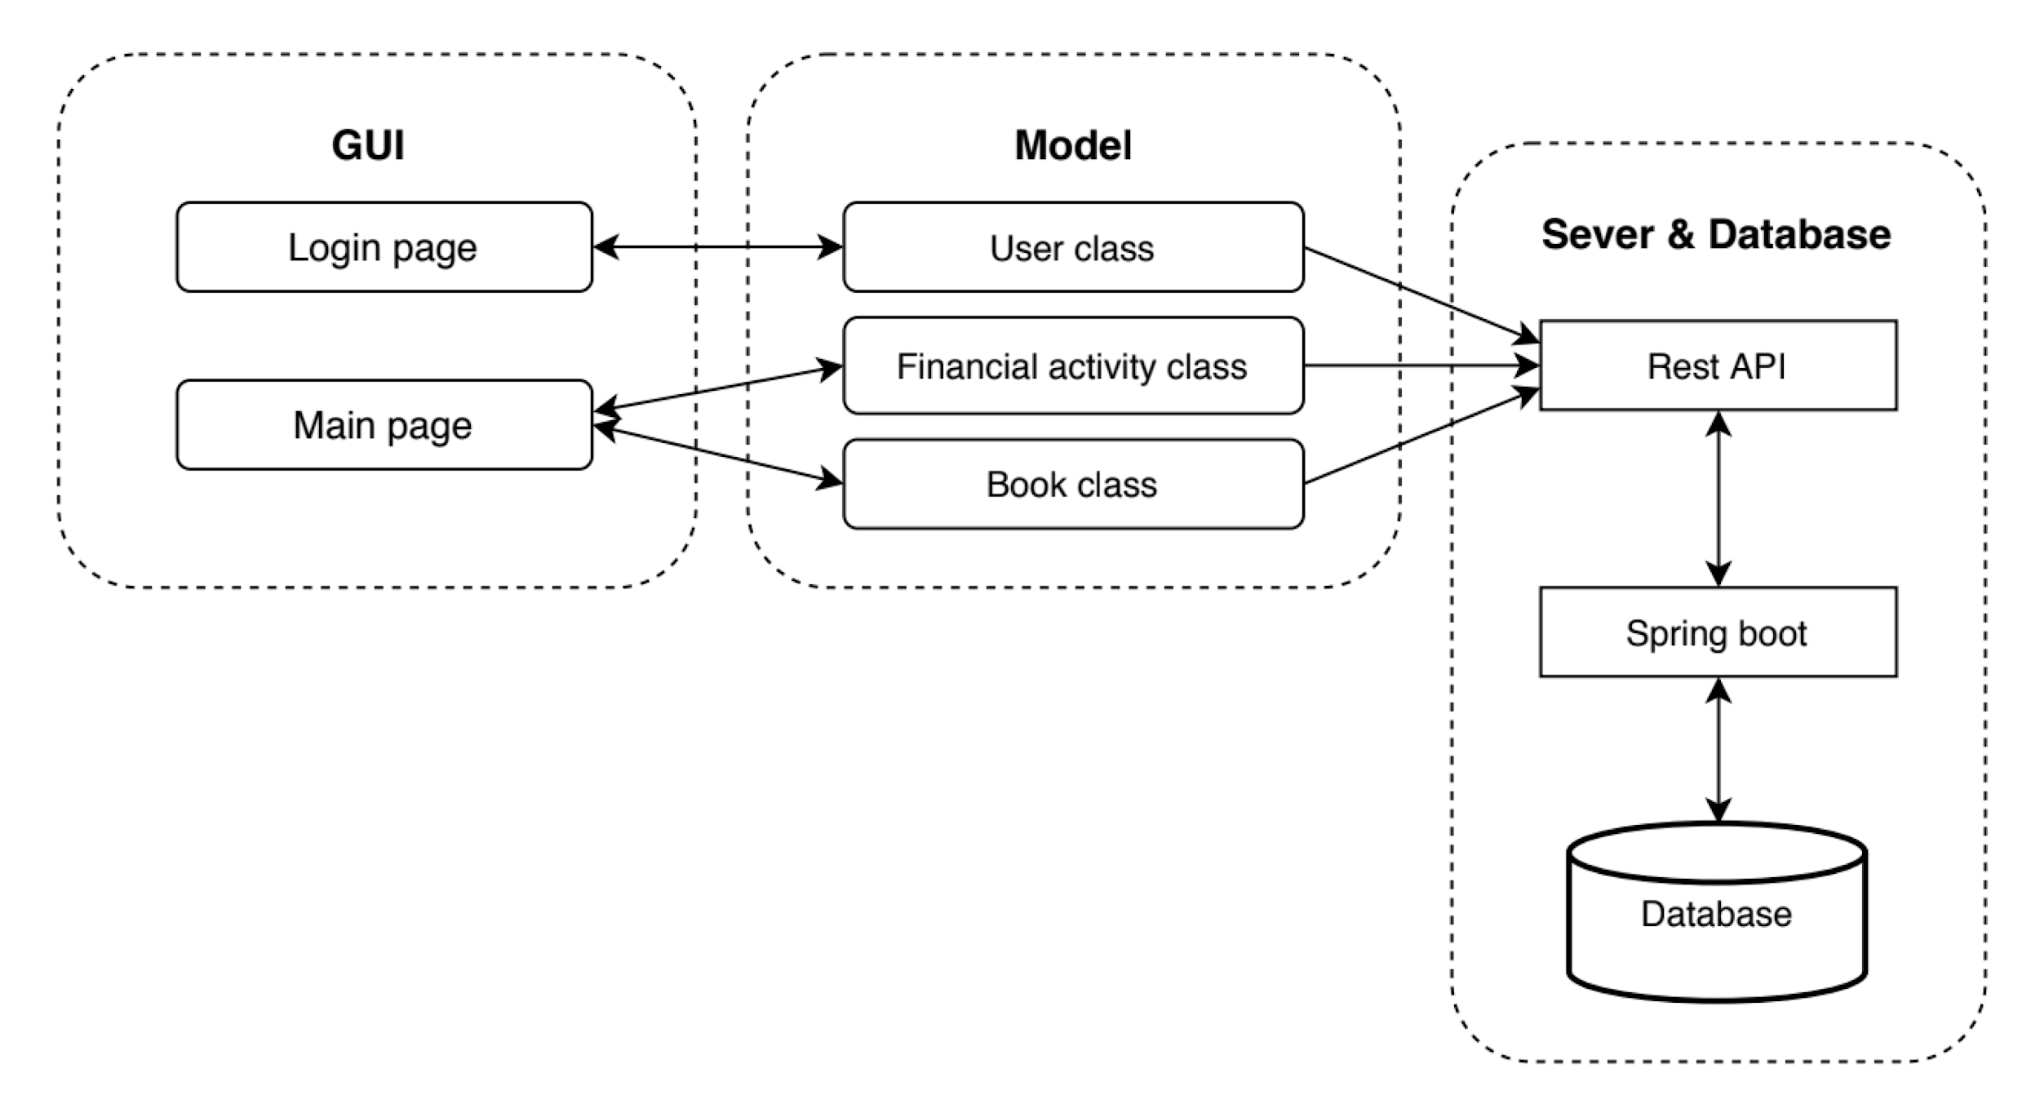
Architecture

Slide 4
Technology Lesson learned
Lessons learned
Waterfall model:
Have made some changes on the implementation of group functionality.
Version Control:
Use branches to separate everyone’s progress
Merge branches if fully tested
Bug backtracking
Unit testing:
Use JUnit test and coverage measure.
Front end: Jframe, Java, REST API
Back end: Spring boot framework
Database: Postgres
Testing: JUnit
Version Control: GitHub
Bug reporting: Google Document

Slide 5
Key Functionalities
Allow users to register, login, and reset passwords
Allow users to create/delete accounting books
Allow users to add/remove book members
Allow users to add/view/delete financial activities
Allow users to split costs with other book members
Allow users to view daily, monthly, and yearly spendings

Slide 6
Demo

